Slide 1
Nurses Honoring Nurses
Notes:
Welcome Everyone!
Thank you for taking the time and making the effort to be here today.
In the early days of this organization, meetings were small, budgets were zero to minimal, and often took place in the homes of volunteers who were willing to open their doors and welcome us in, throughout the state.
This was our early attempt to stay connected to our volunteers statewide.
Today is the first time that we have been able to invest in meeting like this, on this magnitude, as our budget is now able to give us more leeway.
Today is a product of our achievements!
We are proud of or growth and volunteer work and we are proud of each and every one of you who continue to keep our mission alive through your active participation within this organization. So today is just one small way that we can thank you and be able to connect with you in person.

Slide 2
Mission
To honor those who have dedicated their lives to the profession of nursing
To recognize nurses at the time of their passing
To perform ceremonial traditions to honor the career of the fallen nurse
To provide a tribute, free of charge, to any licensed/registered or advanced practice nurse, active or retired in Wisconsin

Slide 3
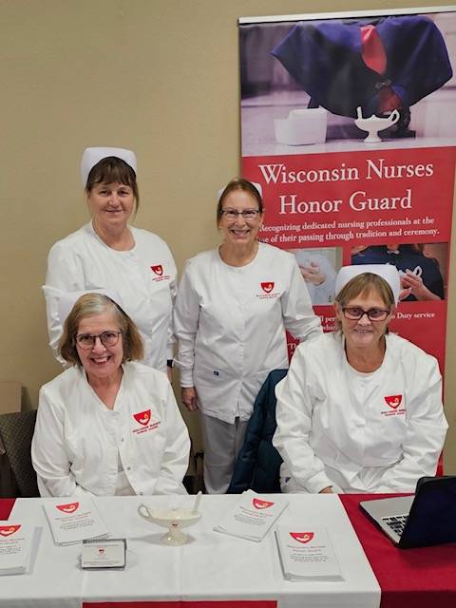
The Services we offer
We offer an approximately 5–8-minute Final Call ceremony for LPNs, RNs, or APRNs who have passed within the State of Wisconsin.
A group of 3-5 nurses attend in traditional white nursing uniforms including nursing hats. Some members also wear white dresses with traditional blue capes.
We have attended services at many types of venues, such as graveside, funeral homes and churches, celebrations of life in bars or restaurant. We are open to almost anything.

Slide 4
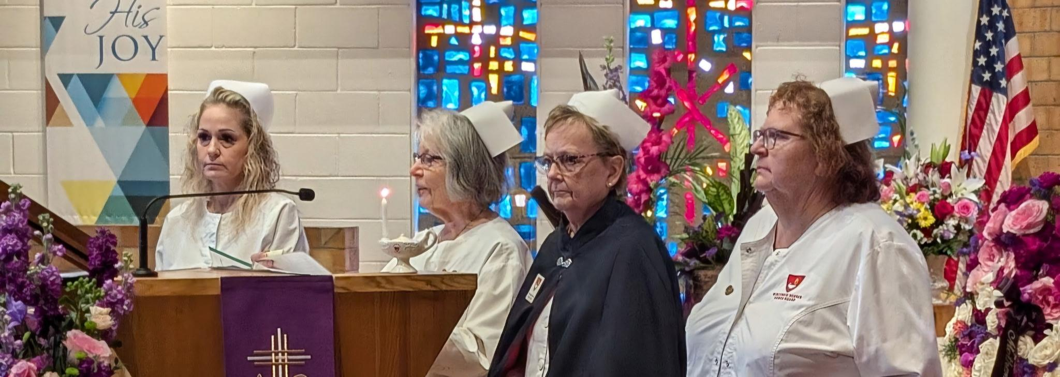
The Final Call to Duty Service:
Light a Nightingale Lamp
Read a script that includes personal information about the nurse and their career
Ask fellow nurses to stand and recite the
Nightingale Pledge and/or a Poem, “(S)He was There
Do a Final Call to Service and release the honoree from duty
Provide the designated family member with a gift of a white rose.

Slide 5
Living Tributes can be requested for nurses who are in hospice care. We partner with the hospice provider to provide a service that both recognizes and thanks the honoree for their service.

Slide 6
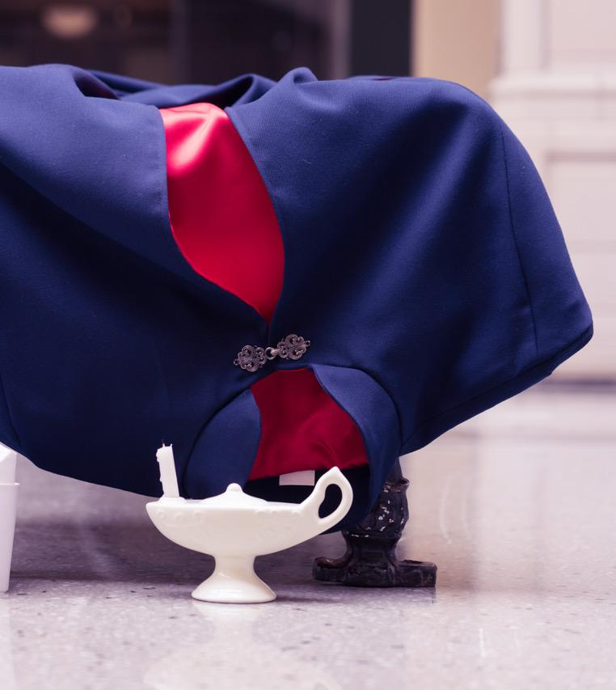
Wisconsin Nurses Honor Guard offers services in all areas of Wisconsin (and we’ve hopped over a border in the past).
We have over 350 members from all over the state.
We have no paid employees and are entirely volunteer driven.
In 2024 we performed 138 services throughout Wisconsin.
We are a registered charitable organization (501(c)(3).
When finances allow, we provide nursing scholarships to schools of nursing in the State.
We are available for special events such as Honor Flight Welcome Home celebrations, Nursing Alumni tributes at annual meetings, Decommissioning of Health Care Buildings, Pinnings at Nursing Graduations (and are open to other ideas).

Slide 7
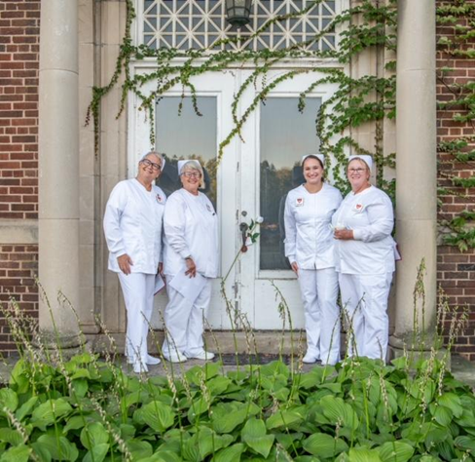
Contact us to request a service or volunteer:
www.winurseshonorguard.com
Follow us on Facebook or Instagram

